Slide 1
Introduction to SCARES Mesh NETWORK
For
SCARES
South County Amateur Radio Emergency Service
Amateur Radio EMCOMM
Gary Aden, K6GDA
Nov 19, 2015

Slide 2
Outline
What is a Mesh network
What is a MESH node?
Advantages of Mesh Networks
MESH and Amateur Radio
Hardware
Software
The SCARES MESH

Slide 3
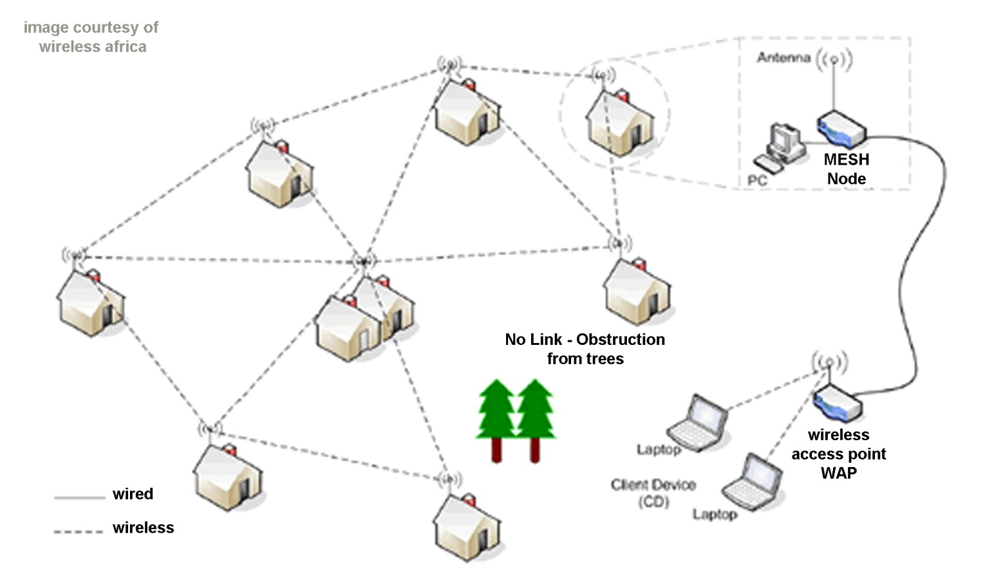
What is a MESH Network?
A MESH network is a group of MESH nodes that wirelessly communicate with each other

Slide 4
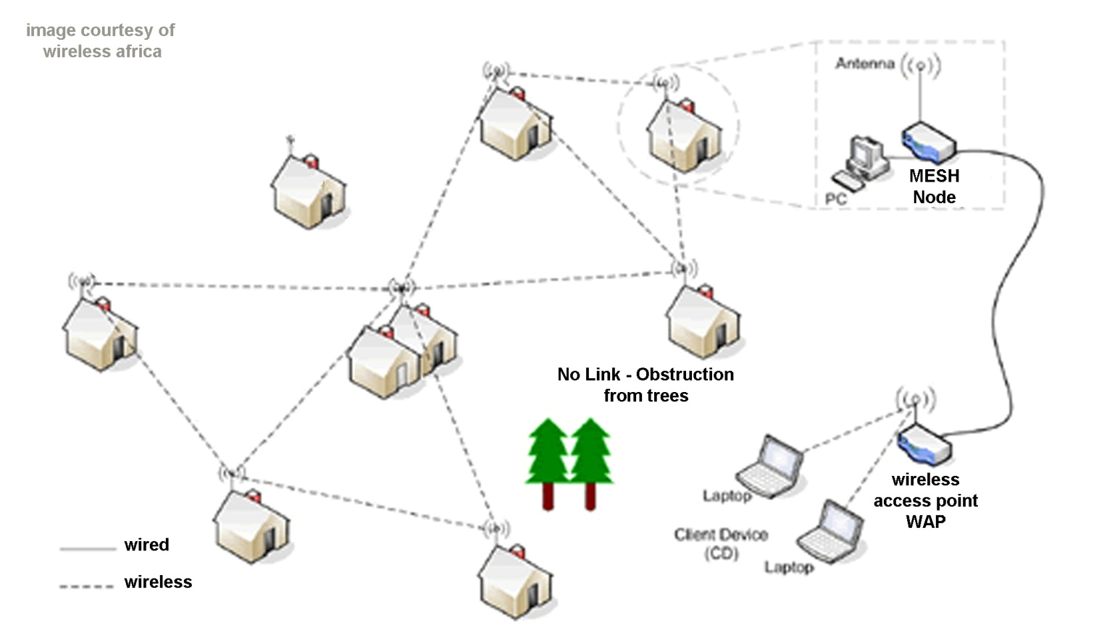
What is a MESH Network?
If one MESH node drops the remainder of the MESH can still function

Slide 5
What is a MESH Network?
If the MESH node is restored then the net is self discovering and…

Slide 6
What is a MESH Network?
If the MESH node is restored then the net is self discovering and…self healing

Slide 7
What is a MESH Node?
• Each node…
Is a radio transmitter/receiver with router…
builds a routing table that tracks the other nodes…
will pass data from one to the next until the final connection is made.... completely automatically …
can be remotely managed, you do not need physical access once installed.
• If any node is connected to resources it can provide access to the entire network.
internet, video camera, fileserver, mail server, etc.

Slide 8
Advantages of a MESH Network
Does not use or rely on the internet
Does not use or rely on cell towers
Is relatively inexpensive to implement (~ $200/node)
Is self forming and self healing
Can still operates even if part of the mesh network goes down
Has a very low power requirement
Supports relatively high demand
Can pass written text and pictures

Slide 9
MESH and Amateur Radio
802.11g Wireless Band

Slide 10
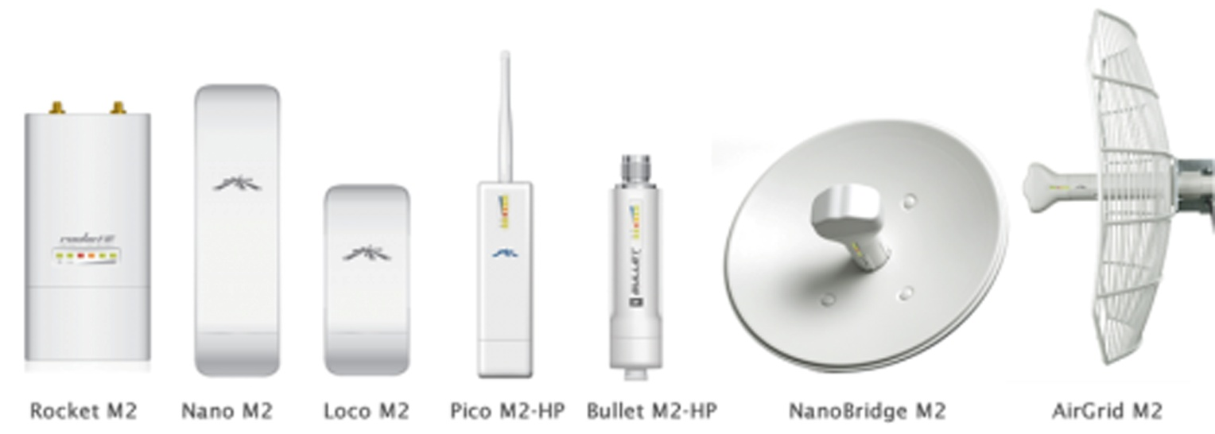
Hardware - Ubiquity
Ubiquiti 2.4GHz (13 cm band)
Pico M2, $79
Bullet M2 HP, $76 + antenna
AirGrid M2 HP, $69
NanoStation Loco M2, $69
NanoStation M2, $79
Rocket M2, $79 + antenna

Slide 11
Software - AREDN
AMATEUR RADIO EMERGENCY DATA NETWORK
AREDN Project software
written for MESH emergency data network
a new method of providing high-speed data
uses in the amateur radio frequencies
It comes in part from the developers of Broadband Hamnet which was formerly known as HSMM-MESH.

Slide 12
MESH – Can You Connect?

Slide 13
Typical MESH Status

Slide 14
MESH Status (SCARES Nov 2015)

Slide 15
MESH-What’s Next?
Get more SCARES nodes active
Get more EOC’s connected
Start connecting CERT trailers
Set up a protocol for using a MESH in an emergency
Start practicing using MESH along with Voice
Set up Demo’s for the cities and county SCARES serves

Slide 16
MESH
Thank you

